Slide 1

AI-Powered Candidate Assessment for Smarter Hiring
Enhancing Hiring Efficiency with AI Agents

Slide 2
Agenda
Team Introduction - Define the team
Problem Statement & Market Landscape
Value proposition
Solution Definition (Diagram)
Key Features
Demo
Roadmap & Next Features
Conclusion & Call to Action
"Join us in shaping the future of hiring with AI!"

Slide 3




Team Introduction - InsightHire
Neil Rodriques
Satya Sai Srinath
Saahil Shroff
Alwin Eldhose Babu
Eng./
Hiring Manager
Dev
Dev
Product

Slide 4

The Hiring Challenge
Quantifying expertise is Hard
Limited time for Interviewer Prep
Recruiters lack Technical Expertise
Inefficient Hiring Processes
Unstructured candidate data
Notes:
🔹 Quantifying Expertise is Hard – Organizations struggle to objectively measure skills in highly specialized fields.
🔹 Limited Time for Interview Prep – Hiring managers and panels lack the bandwidth to deeply analyze candidates' skill sets.
🔹 Recruiters Lack Technical Expertise – Non-technical recruiters often cannot accurately evaluate candidates' skills.
🔹 Unstructured Candidate Data – Resumes, GitHub, and Google Scholar profiles contain valuable insights but are difficult to interpret.
🔹 Inefficient Hiring Processes – Without data-driven insights, interviews become generic, hiring cycles get prolonged, and poor decisions are made.

Slide 5
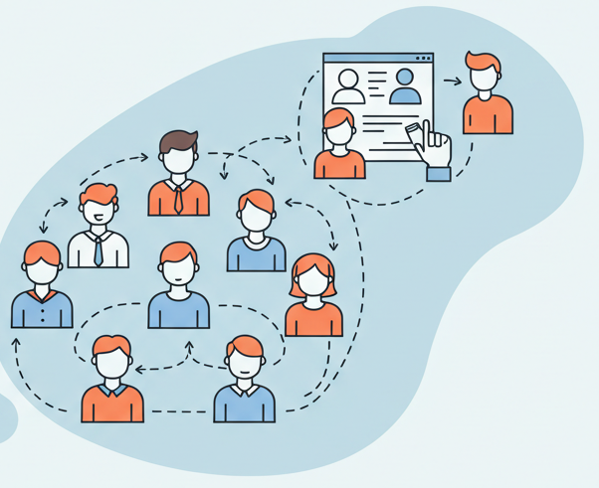
Smarter, Faster, and Fairer Hiring with AI
🔍 Enhanced Candidate Assessment
✅ Quantifies candidate skills with Agent-driven analysis.
✅ Provides a comprehensive profile beyond traditional resumes.
✅ Highlights strengths, weaknesses, and technical competencies.
🎯 Optimized Interviewing Process
✅ Auto-generates tailored interview questions based on skill gaps.
✅ Helps hiring teams focus on the most relevant topics.
✅ Leads to more informed and structured interviews.
Notes:
🔍 Enhanced Candidate Assessment
✅ Quantifies candidate skills with data-driven analysis.
✅ Provides a comprehensive profile beyond traditional resumes.
✅ Highlights strengths, weaknesses, and technical competencies.
🎯 Optimized Interviewing Process
✅ Auto-generates tailored interview questions based on skill gaps.
✅ Helps hiring teams focus on the most relevant topics.
✅ Leads to more informed and structured interviews.
⏳ Time & Cost Efficiency
✅ Automates initial screening and interview structuring.
✅ Reduces time-to-hire and lowers recruitment costs.
✅ Improves quality of hires with better candidate-job fit.
⚖️ Bias Reduction & Objectivity
✅ Uses data-driven assessments to minimize subjective bias.
✅ Ensures fairer, more effective hiring decisions.

Slide 6
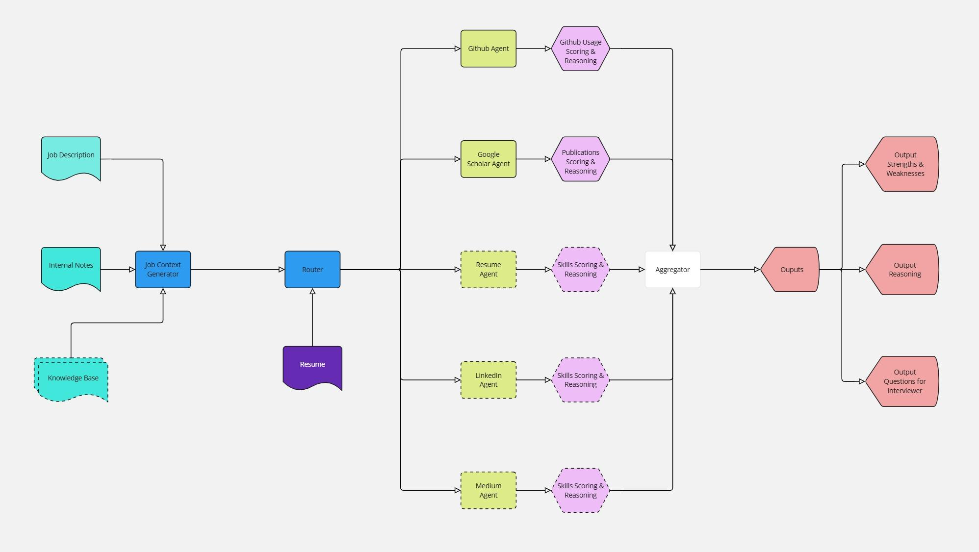
System Diagram
Notes:
🚀 AI agents analyze resumes, GitHub, Google Scholar, and other sources.
📊 Generates a candidate skill score based on technical and soft skills.
🎯 Identifies strengths and weaknesses for precise evaluation.
📝 Suggests focused interview questions for optimal assessment.
📌 Provides structured interview guidance for hiring teams.

Slide 7
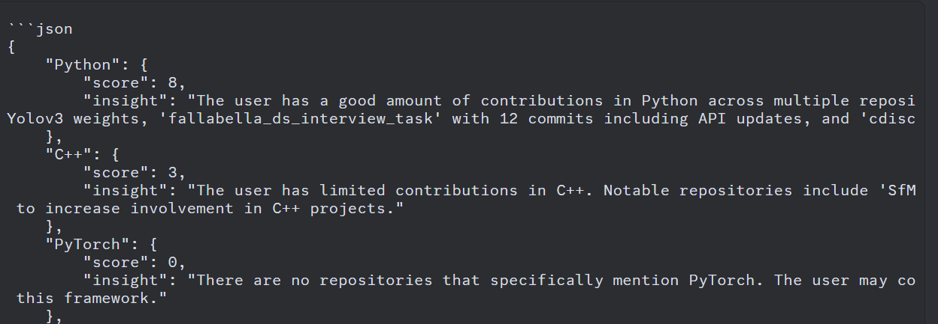
Notes:
🚀 AI agents analyze resumes, GitHub, Google Scholar, and other sources.
📊 Generates a candidate skill score based on technical and soft skills.
🎯 Identifies strengths and weaknesses for precise evaluation.
📝 Suggests focused interview questions for optimal assessment.
📌 Provides structured interview guidance for hiring teams.

Slide 8
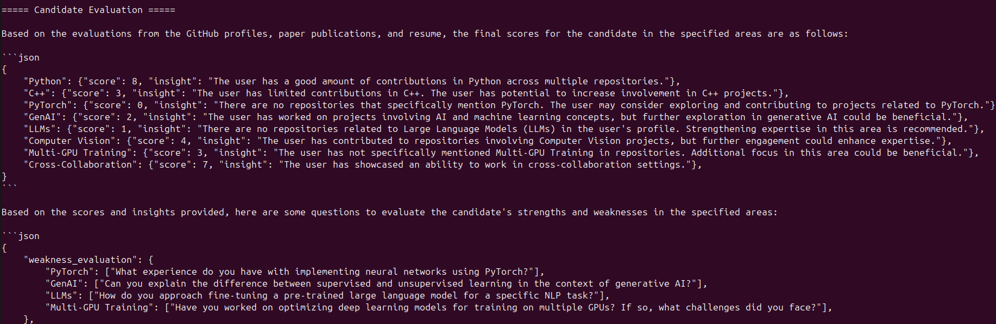
Notes:
🚀 AI agents analyze resumes, GitHub, Google Scholar, and other sources.
📊 Generates a candidate skill score based on technical and soft skills.
🎯 Identifies strengths and weaknesses for precise evaluation.
📝 Suggests focused interview questions for optimal assessment.
📌 Provides structured interview guidance for hiring teams.

Slide 9

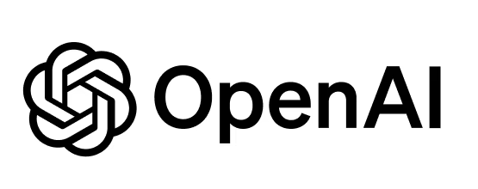

Powering AI-Driven Hiring with Cutting-Edge Technology
🖥️ Core Technologies
✅ LlamaIndex – Efficient indexing and retrieval of candidate data from multiple sources.
✅ OpenAI GPT-3.5 – NLP model for skill analysis, candidate scoring, and question generation.
✅ Python – Backend development, data processing, and AI model integration.
🔗 How It Works
1️⃣ Data Ingestion: Extracts information from resumes, GitHub, and Google Scholar.
2️⃣ Processing & Indexing: LlamaIndex structures and organizes candidate data.
3️⃣ AI Analysis: GPT-3.5 interprets skills, scores candidates, and suggests questions.
4️⃣ Insights & Recommendations: System provides structured interview guidance.

Slide 10
AI-Powered Hiring Workflow
🚀 AI agents analyze resumes, GitHub, Google Scholar, and other sources.
📊 Generates a candidate skill score based on technical skills.
🎯 Identifies strengths and weaknesses for precise evaluation.
📝 Suggests focused interview questions for optimal assessment.
📌 Provides structured interview guidance for hiring teams.

Slide 11
Future Enhancements
🚀 Expand Data Sources: Add Stack Overflow, Kaggle, personal websites.
🚀 Fine-Tune AI Models: Improve accuracy of scoring and question recommendations.
🚀 Integrate with ATS: Seamless integration with hiring platforms.
🚀 User Feedback & Iteration: Refine based on recruiter & candidate insights.

Slide 12
Score | Completeness | Presentation | Creativity | Viability | Team Fit
1 | Incomplete - team does not demonstrate any working code | Incomplete - it’s incomplete | Copy/Paste - the code is literally copy/pasted from somewhere (including GPT) | Not Assessed - team did not assess viability of the project | No explanation - no explanation given
2 | Buggy - team demonstrates some working code | Partially complete - it’s partially complete | Blueprinted - lifted directly from a blueprint or tutorial with no changes to the functionality | Minimal - team is undertaking a moonshot | Questionable - unsure why this team chose this project
4 | POC - team shows working code, no obvious bugs | Complete - it’s complete | Thoughtful - team creates a project with an intent behind it | Viable - the team’s larger idea/goal can be reasonably completed and funded | Good fit - background and project makes sense for most members of the team
5 | User Test Ready - team has deployed the app somewhere and is live demo ready | Wow - it’s complete AND the team shows coordination and flow | Unique - team shows insight into how a technology works and implements it uniquely | Accelerate - this team should apply to an accelerator or raise funding | Strong fit - this team can probably outcompete other teams doing this
Notes:
Blue background = “technical” scoring
Green background = “non-technical” scoring

